Slide 1
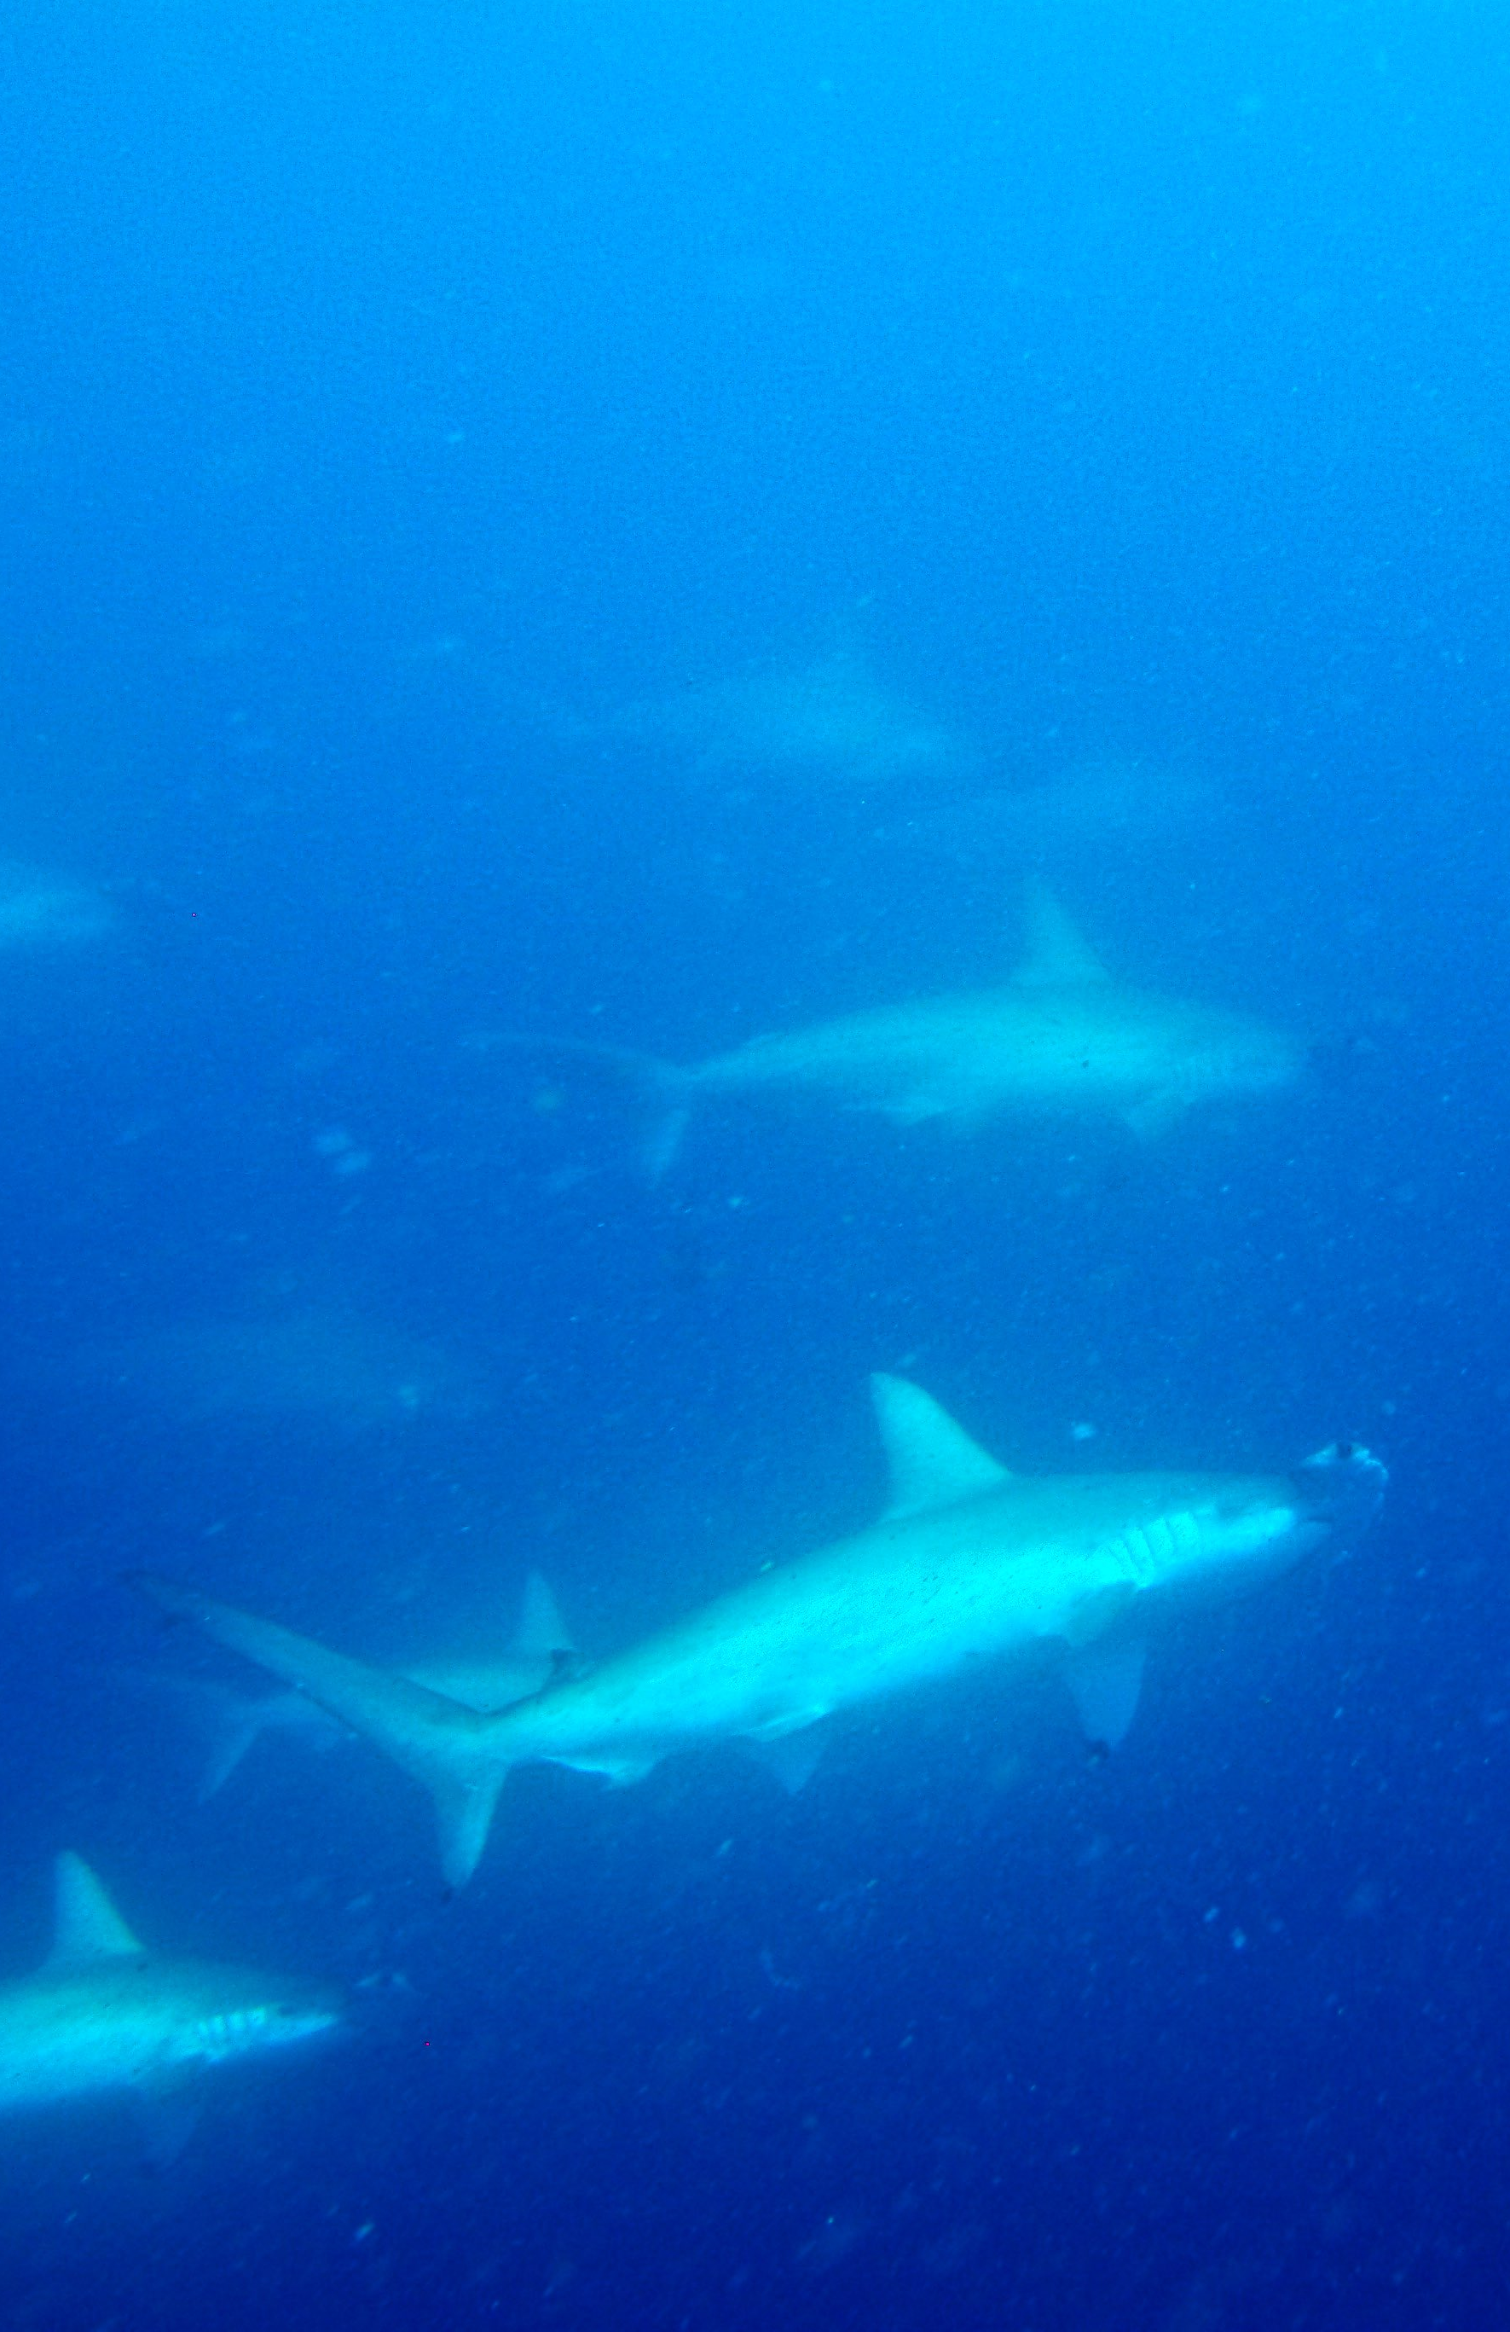


Short Term Economic Impacts of
Marine Reserves
Dan Ovando,
Dawn Dougherty, Jono Wilson
Bren PhD Symposium,
Feb 20 2015

Slide 2
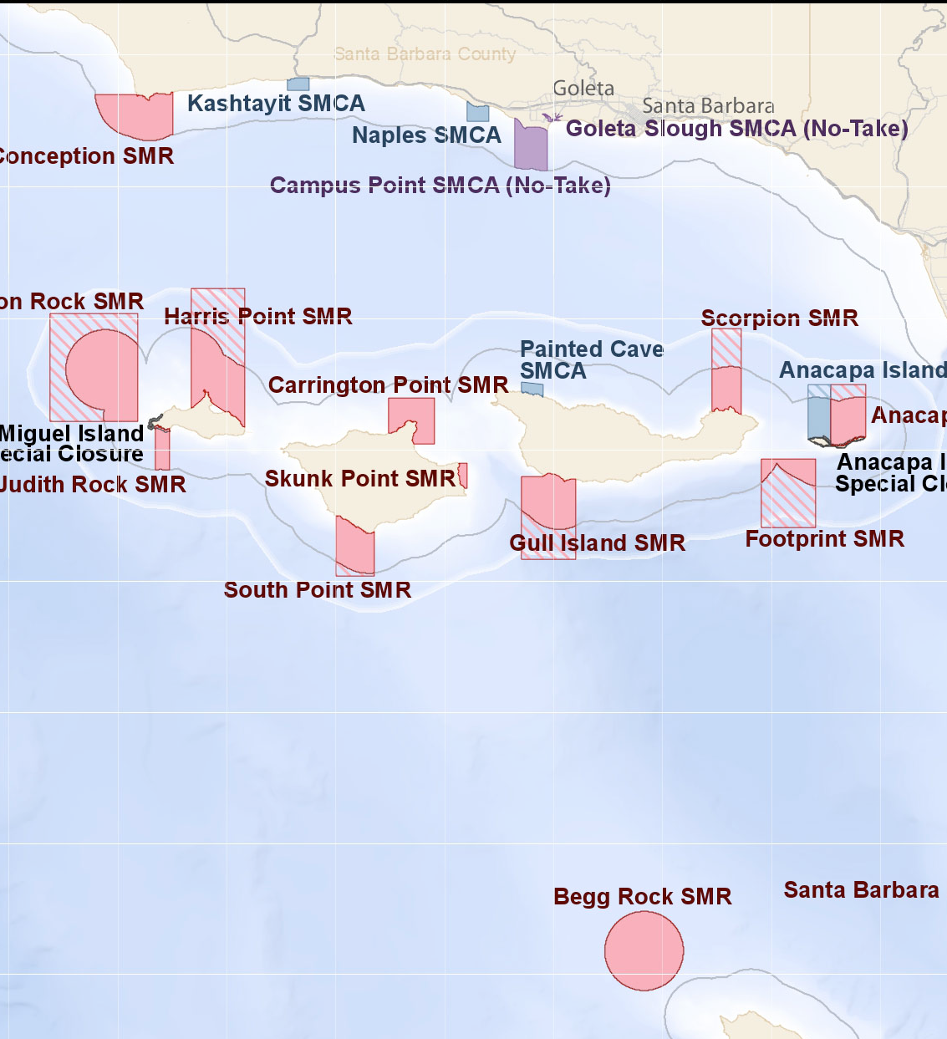
The Science of
Marine Reserves
No-take marine reserve: area of the ocean protected from fishing
Oceans face many risks
Fisheries are a critical source of food, income, and employment
Marine reserves may be a simple and effective tool to protect marine ecosystems and livelihoods
Notes:
You’re making an area off limits to fihsing, we all know that that has important ramifications

Slide 3
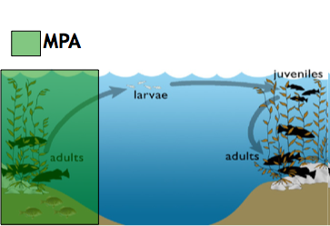
Reserves and Fisheries
Fish inside reserve get larger and more abundant
Act as “bank” for fished area
Notes:
So, the hope is we get more fish inside, we get more fish outside, everybody wins.

Slide 4
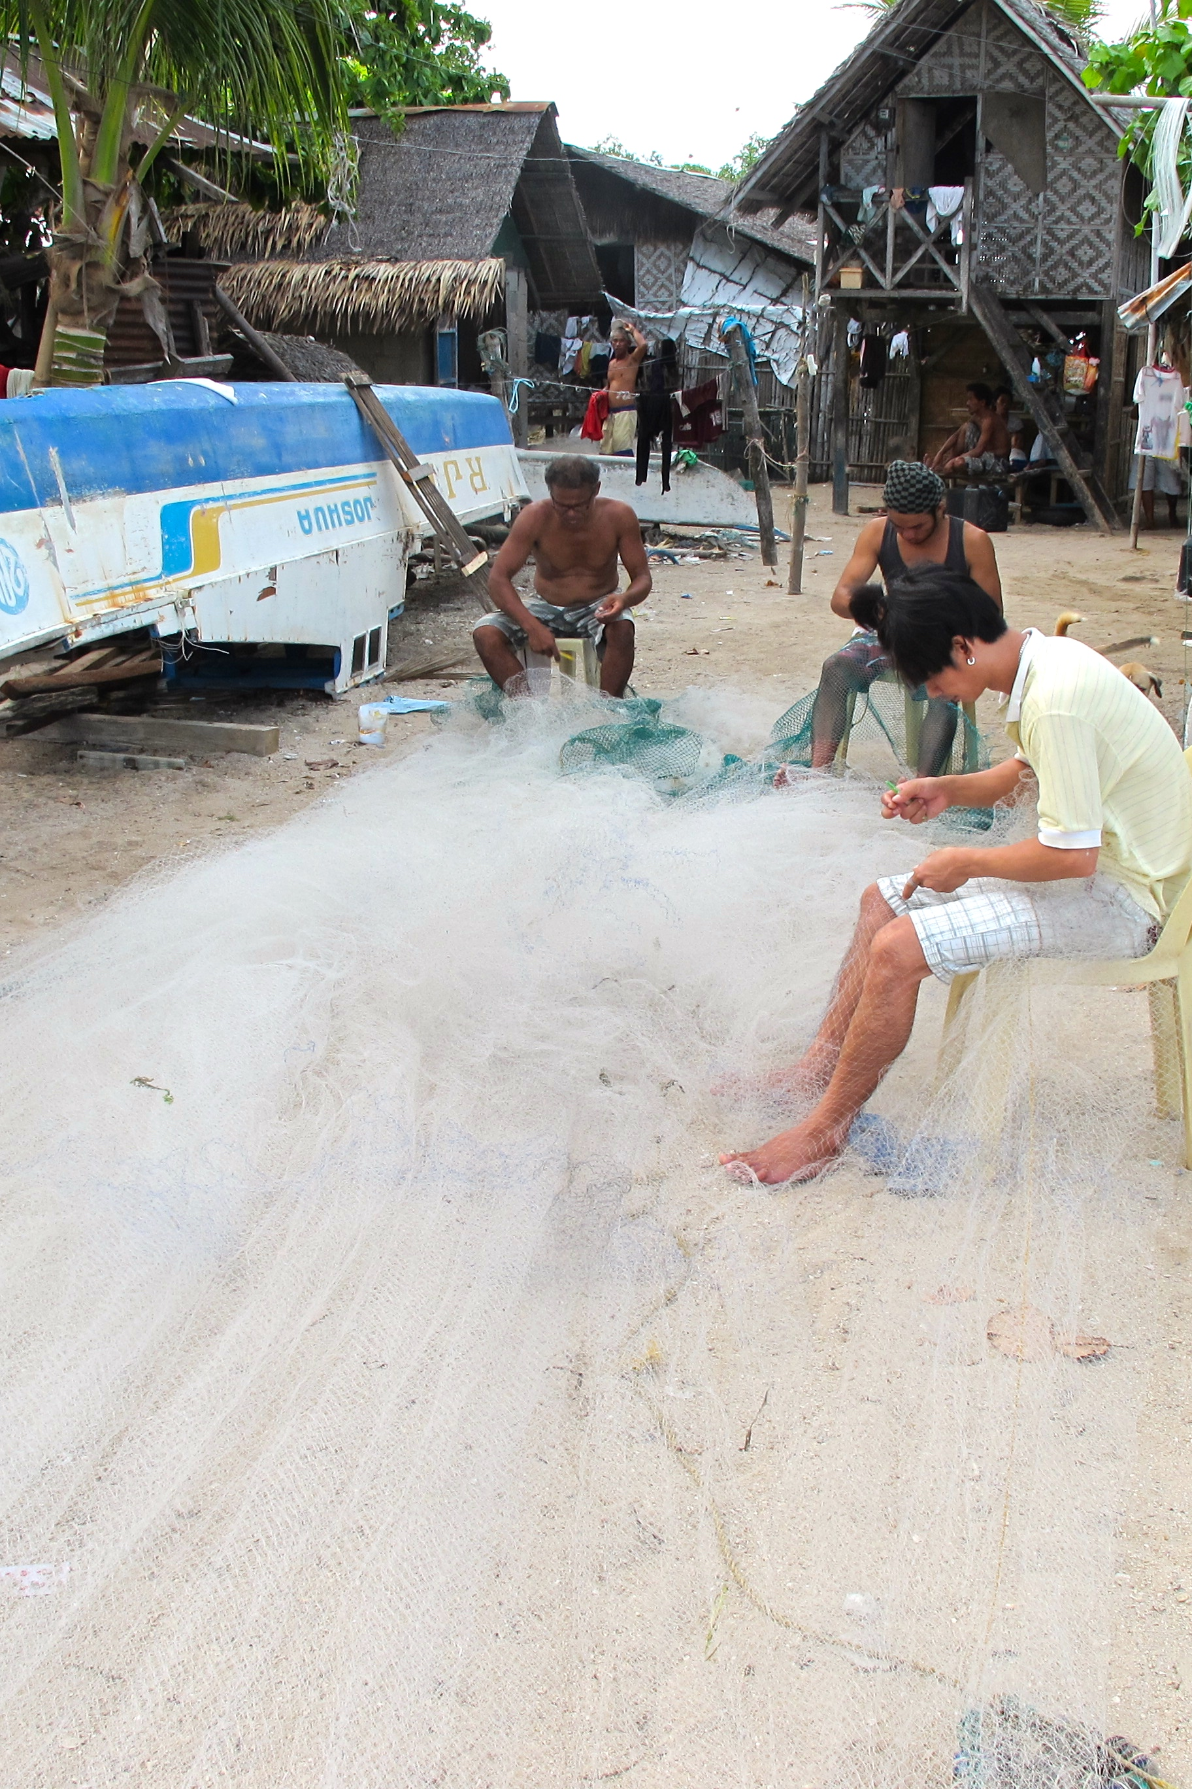
How do reserves affect the short term economic wellbeing of fisheries?
What can we do to offset short term economic losses?
Notes:
Start with motivation: helping communities and ecosystems
What are we going to be looking at

Slide 5
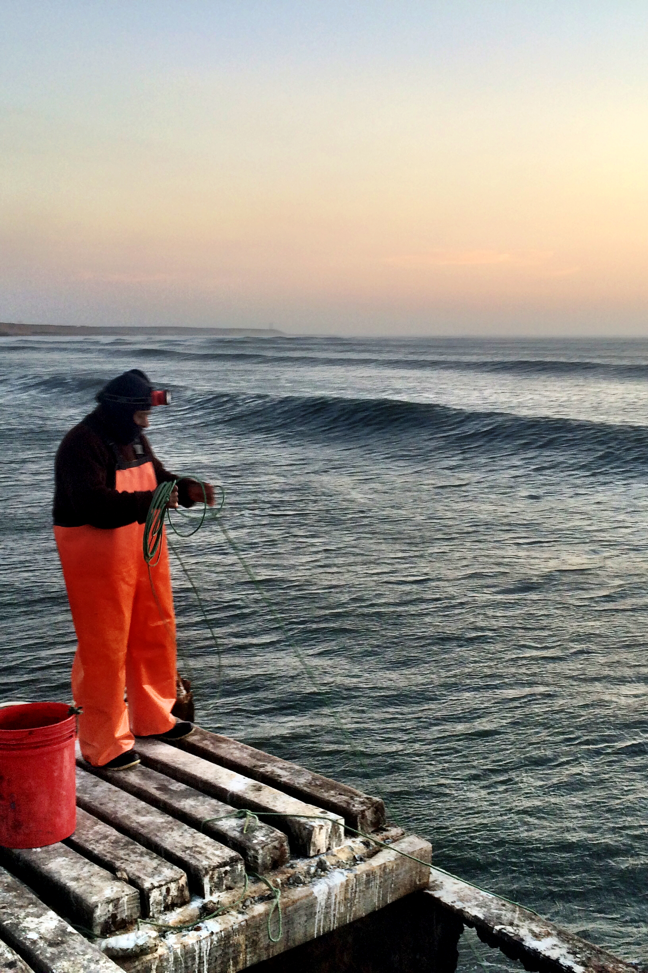
How long until a reserve benefits the community?
Notes:
You’re making an area off limits to fishing, we all know that that has important ramifications
We felt that there’s already a lot of activity focused on this question of do reserves help or not. What’s been missing in this debate though has been a discussion of the short-term, what happens to the community in the first few years after putting a reserve in place.
How long until a communities investment pays off?

Slide 6
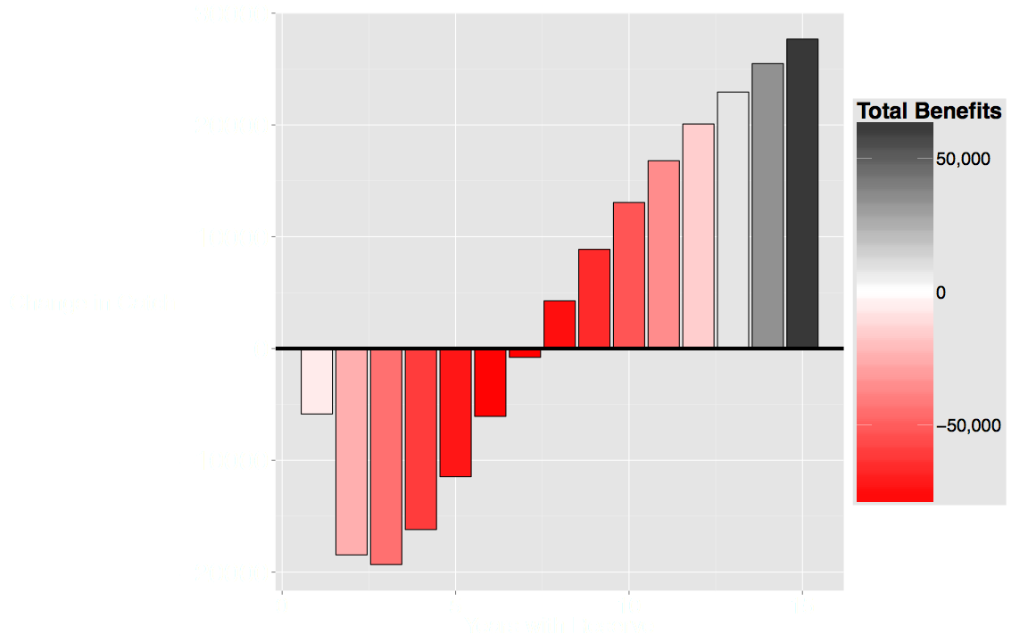
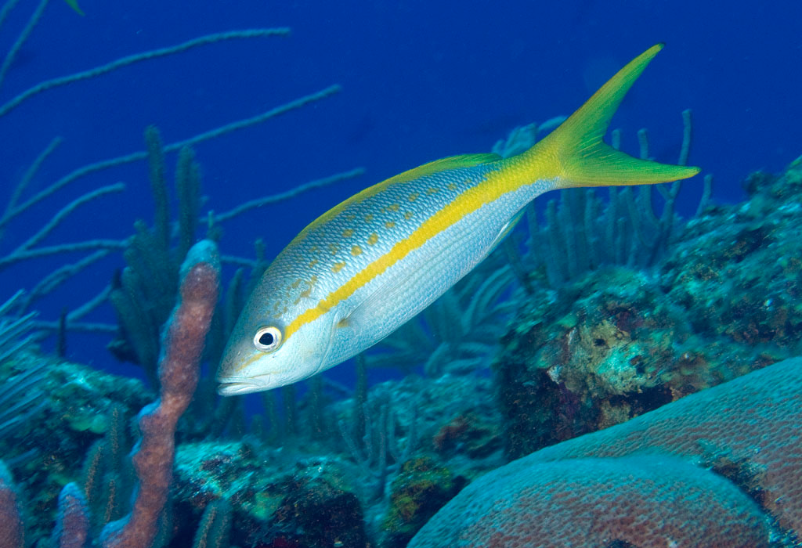
Catch Increases
Reserve Created
Change in
Catch
Net Benefit
Achieved
Notes:
We’re talking about catches
Box around the negative values
Yield Benefit
Conservation benefits
How long does it take for the green area to make up for the red area? How long does it take for the investment to pay off

Slide 7
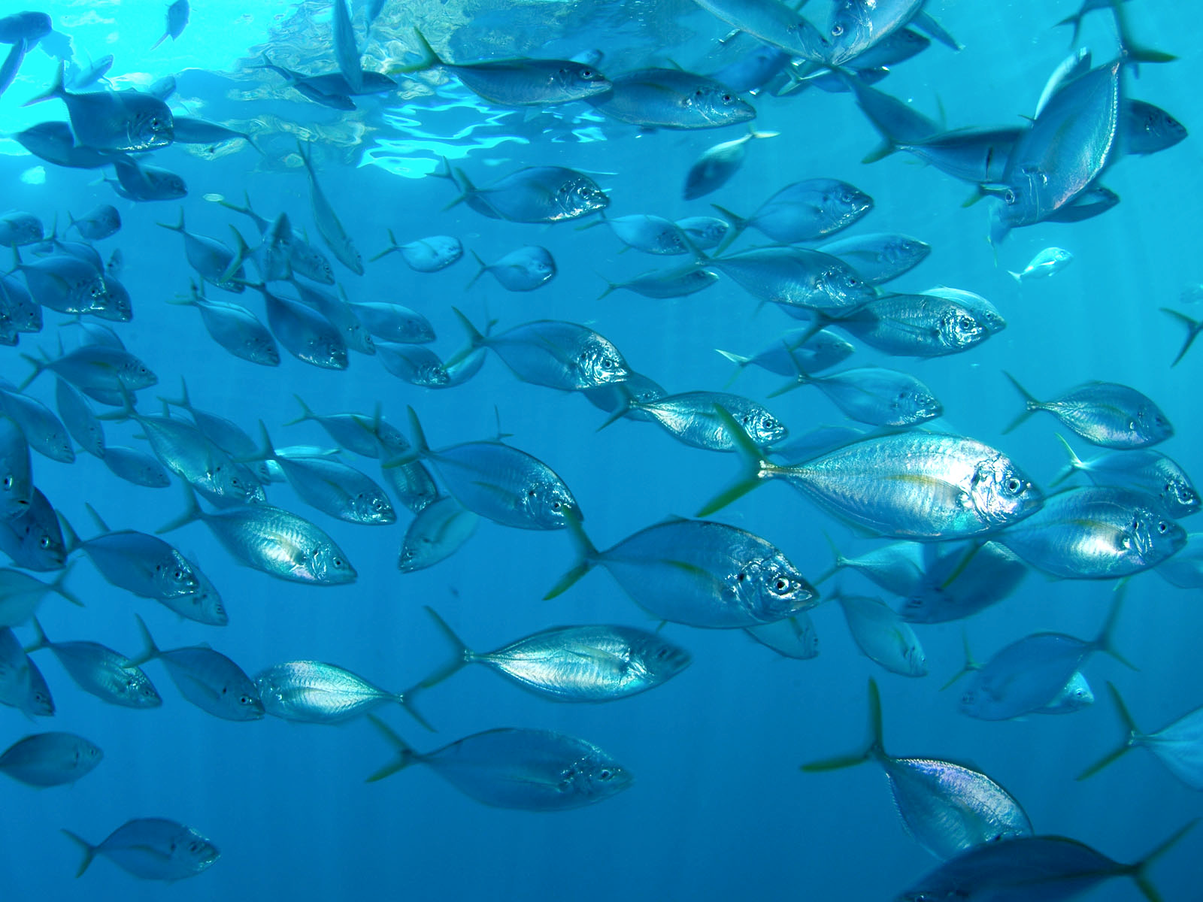
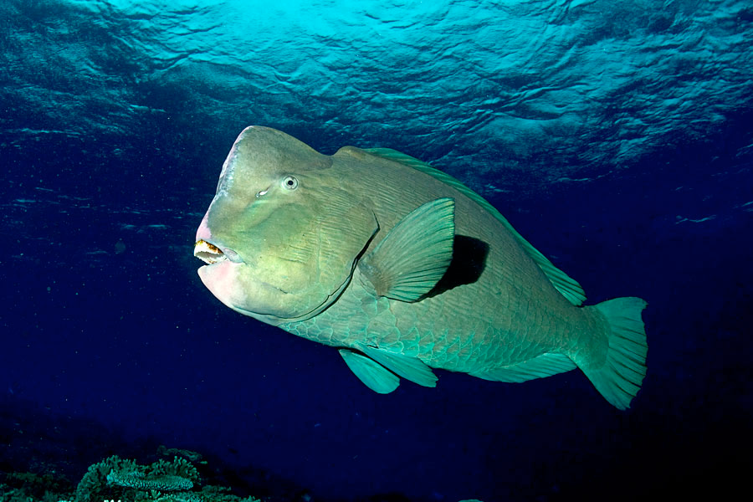
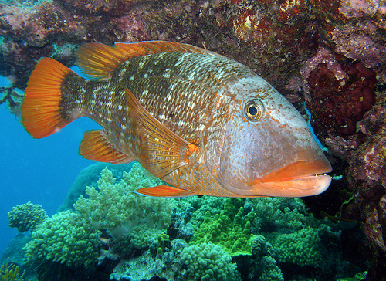
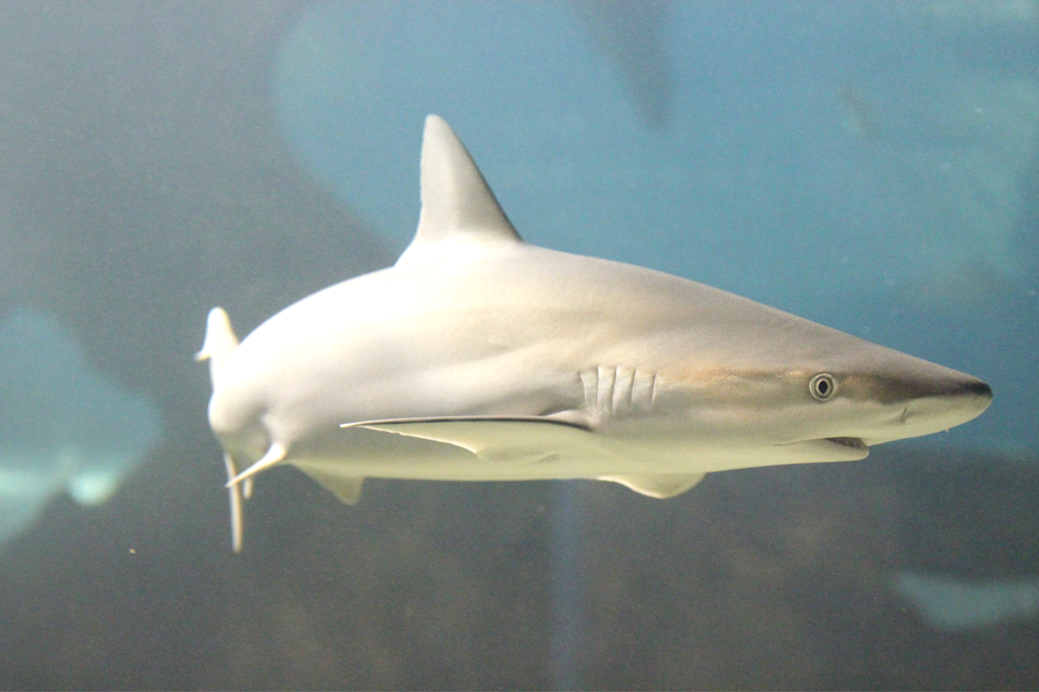
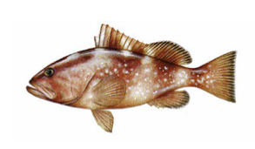
Model Species

Slide 8
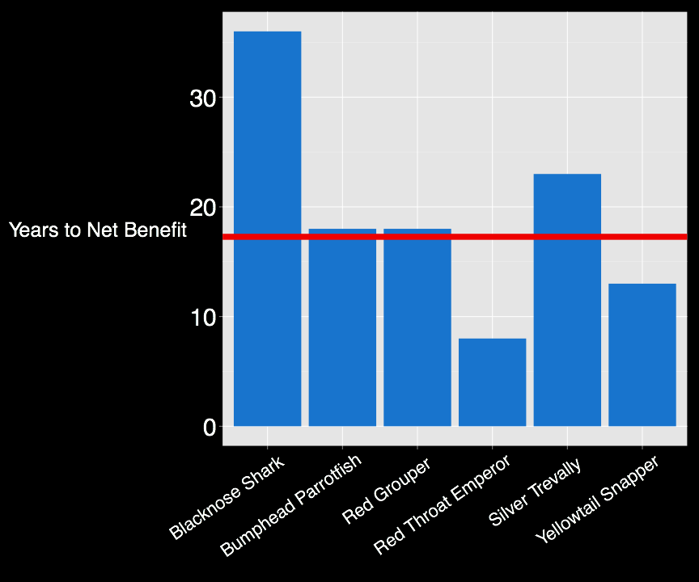
How Many Years until Fishery sees Net Benefits?
Notes:
average is about 17 years for the communities investment in the reserve to pay off

Slide 9
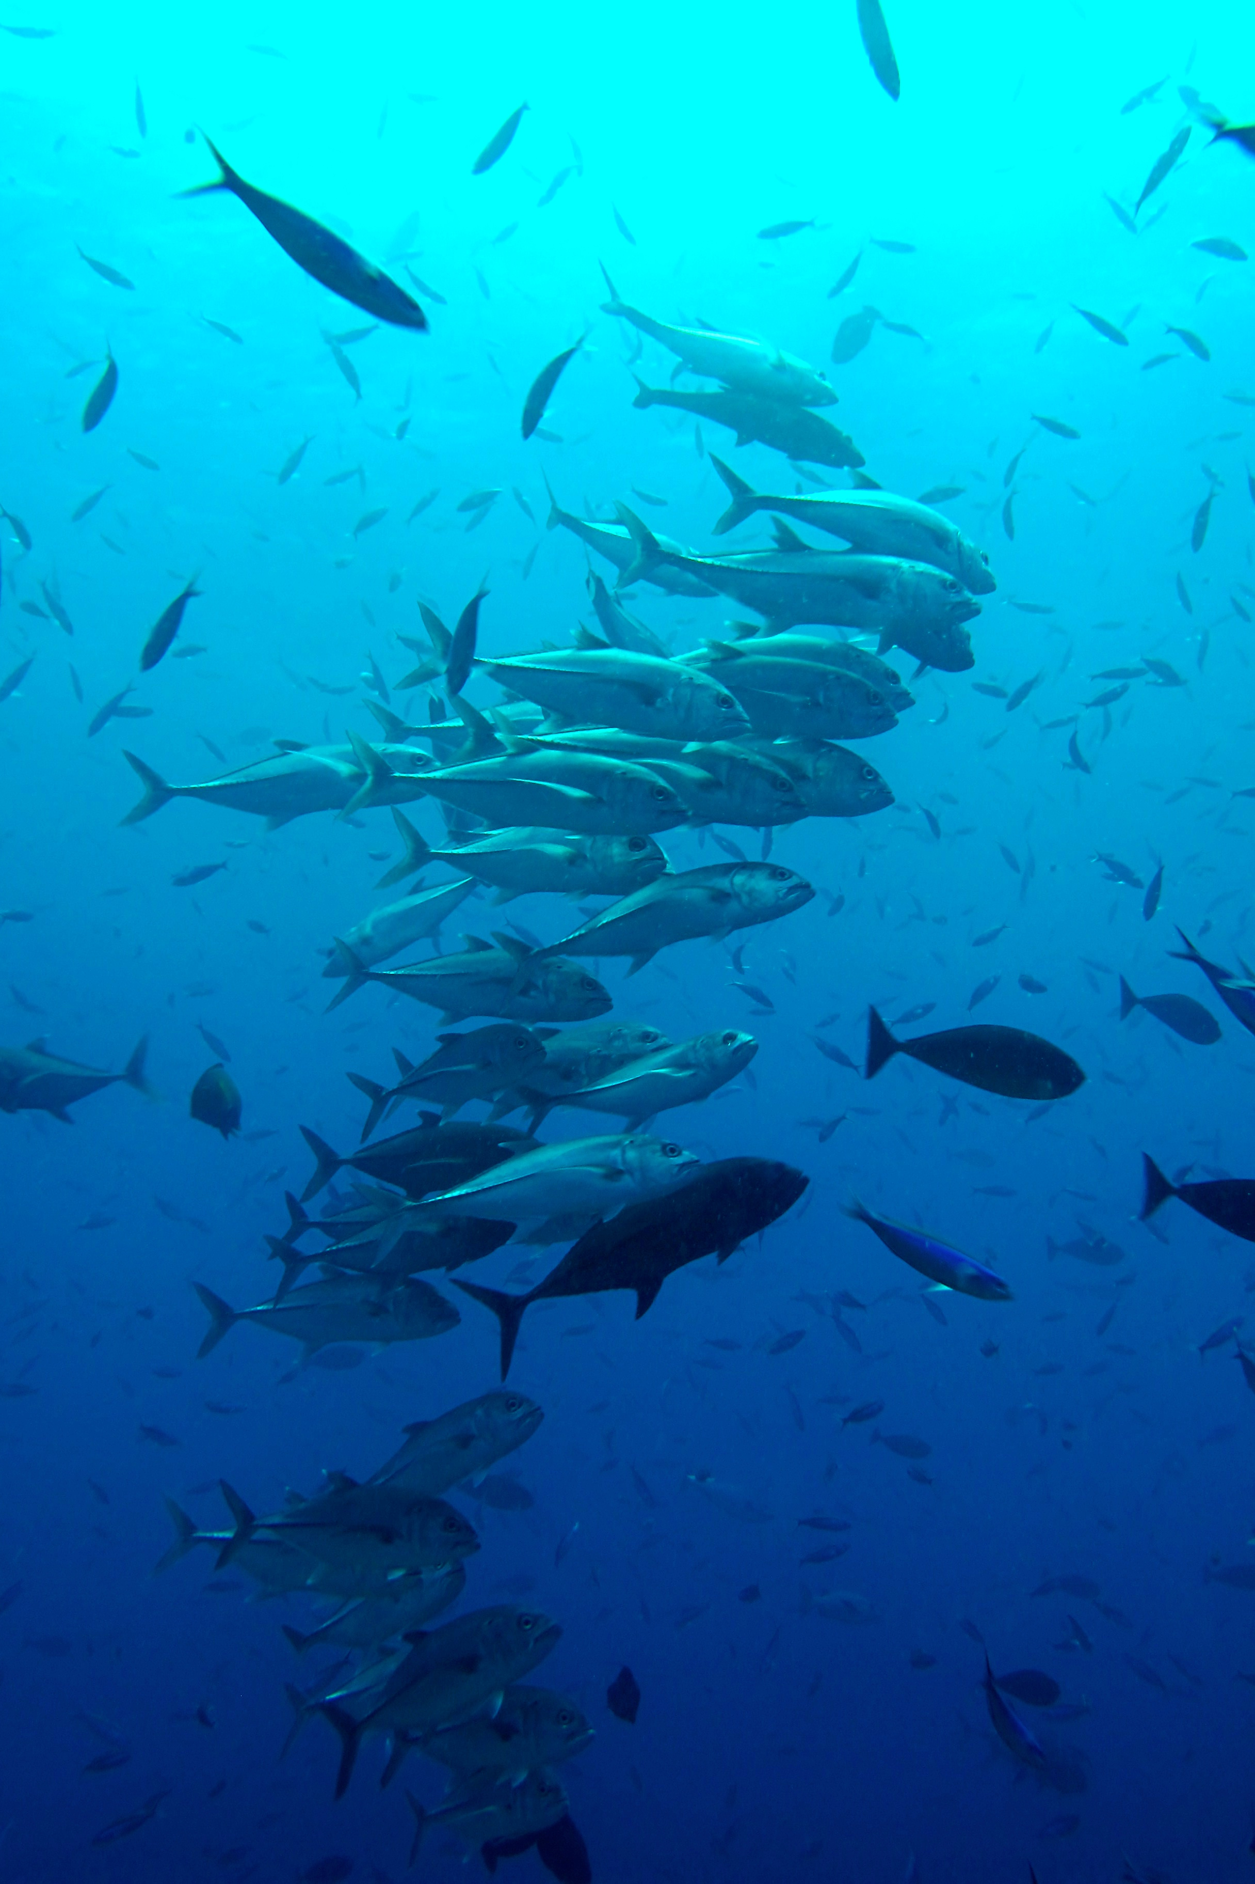
What’s the Solution?

Slide 10
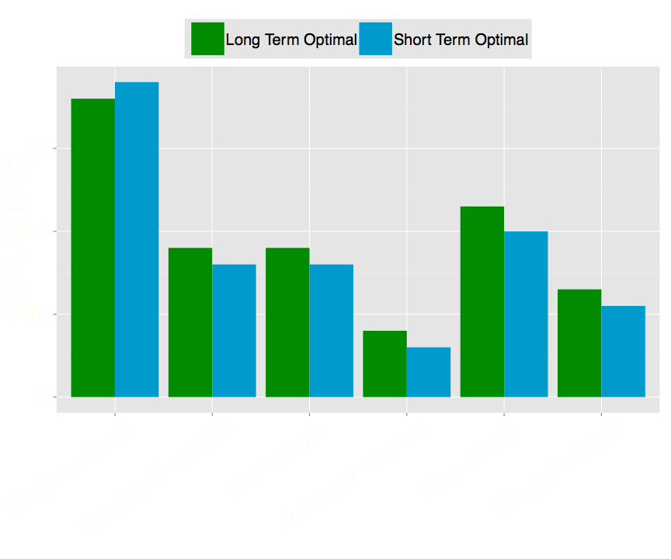
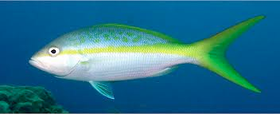
Can Design Help?
Notes:
Long term optimal
Short term optimal

Slide 11
Catch Increases
Reserve Created
Change in
Catch
Net Benefits
Notes:
We’re talking about catches
Box around the negative values
Yield Benefit
Conservation benefits
How long does it take for the green area to make up for the red area? How long does it take for the investment to pay off

Slide 12
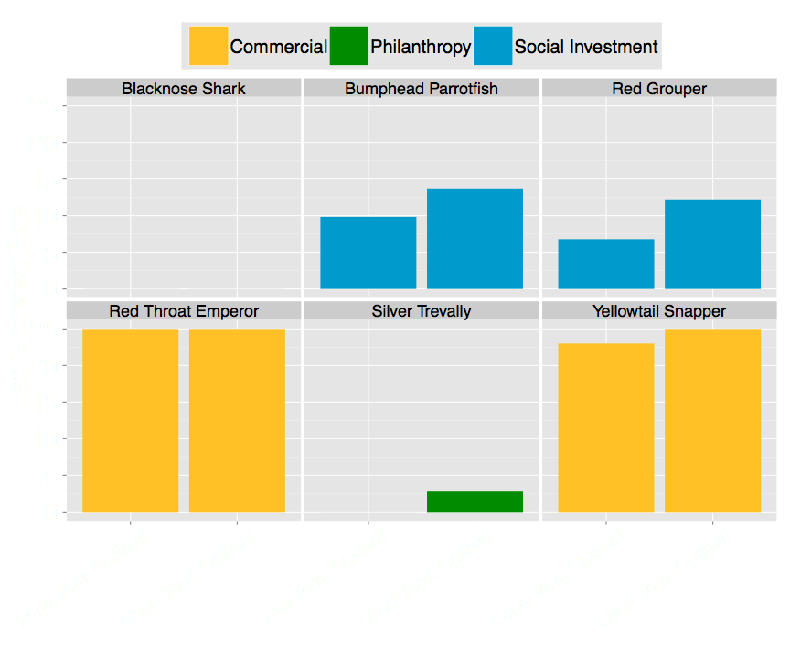
What Kinds of Loans are Possible?

Slide 13
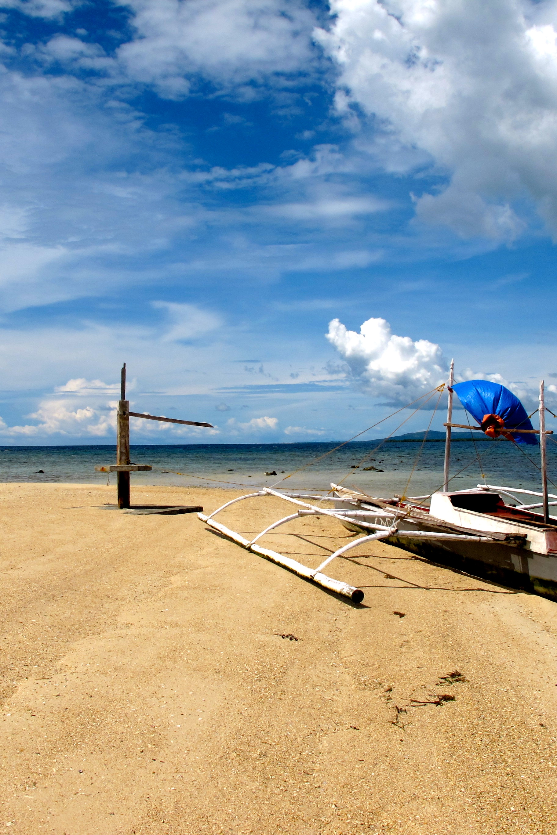
Reserves can benefit fisheries, but often not very quickly
Design, loans, or value increases can help
We need to better assess and communicate the short-term economic impacts of reserves
Notes:
We all want the long term healthy fishery

Slide 14
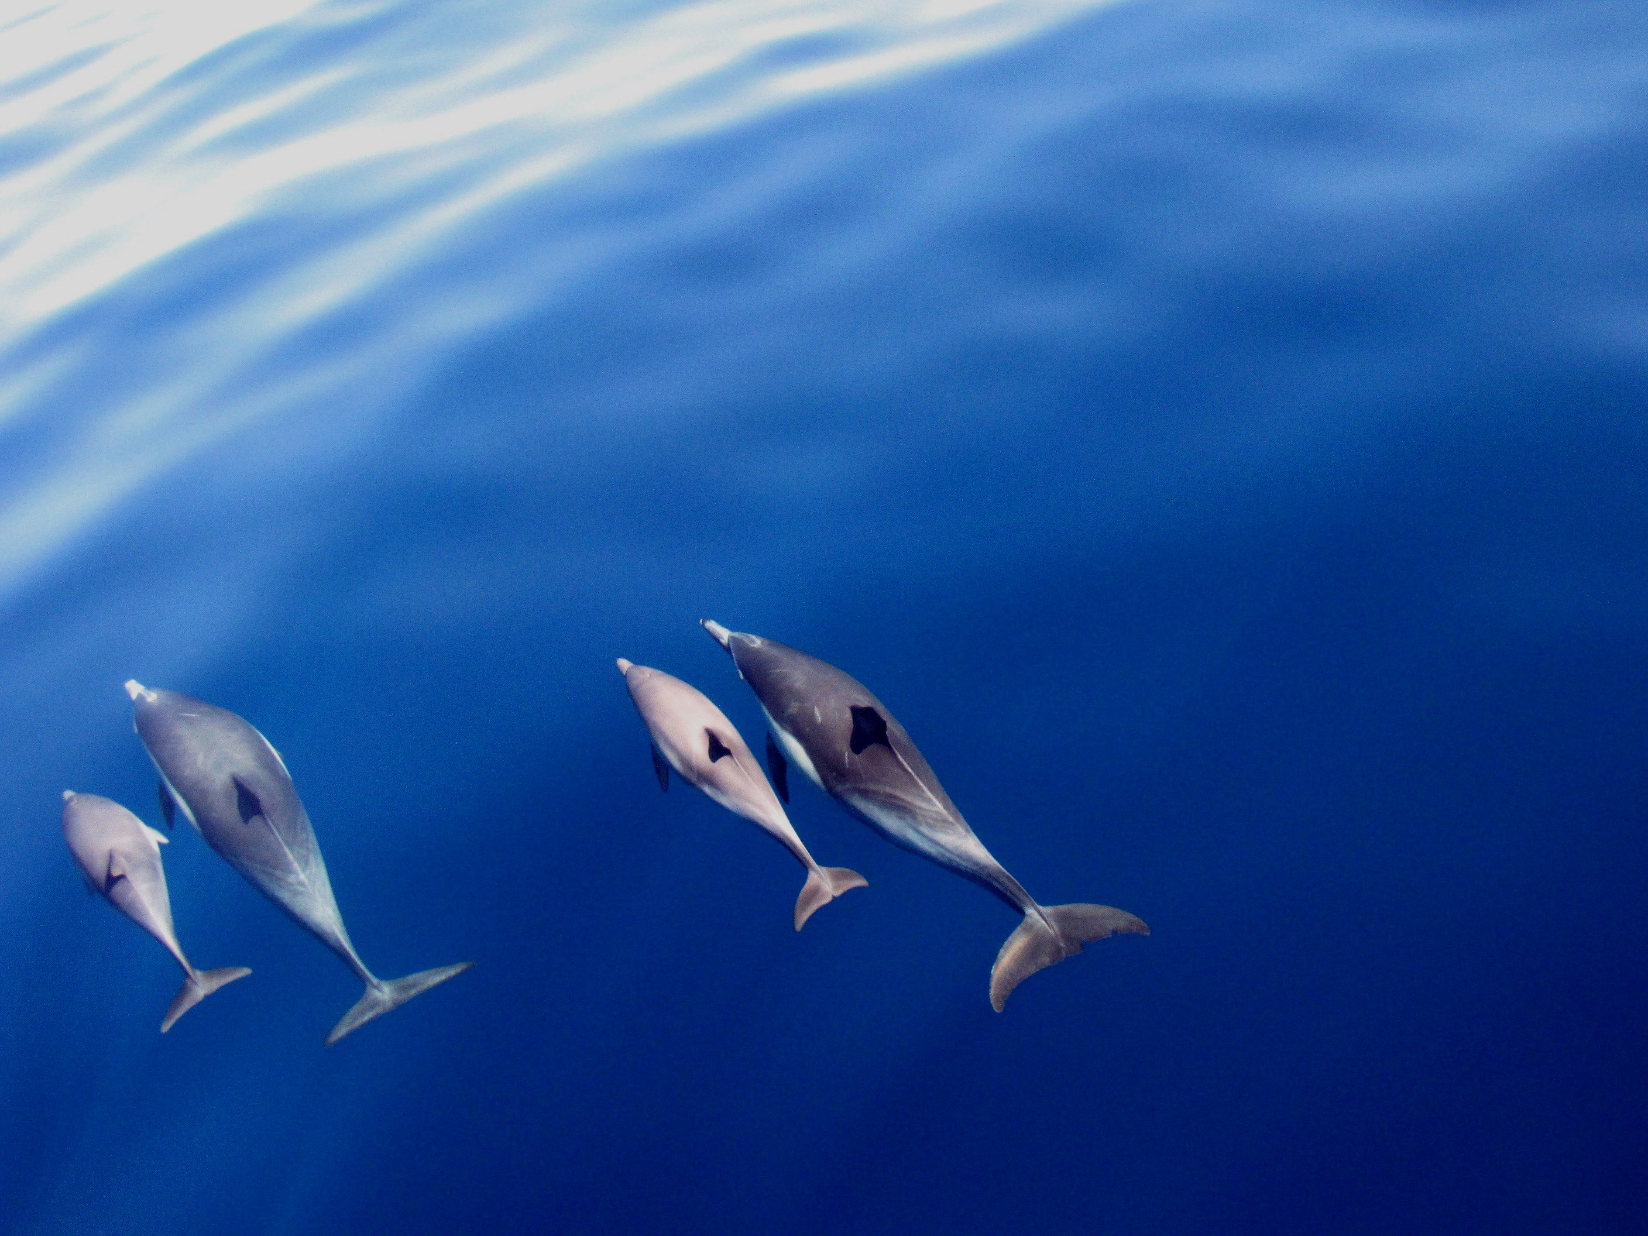
Thank you!

Slide 15
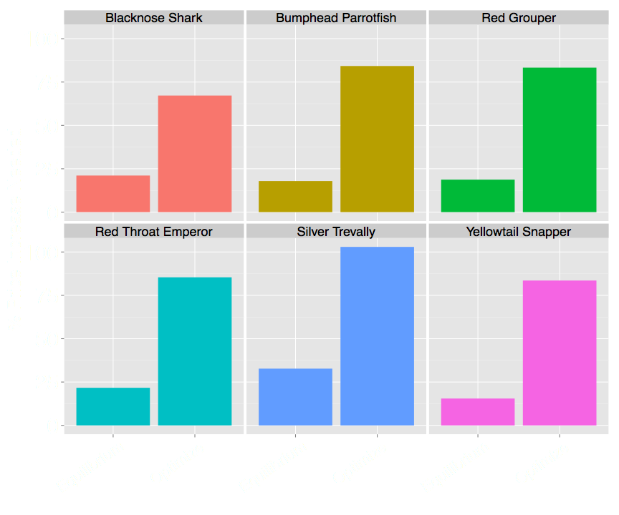
How Much Should Prices Increase?

Slide 16
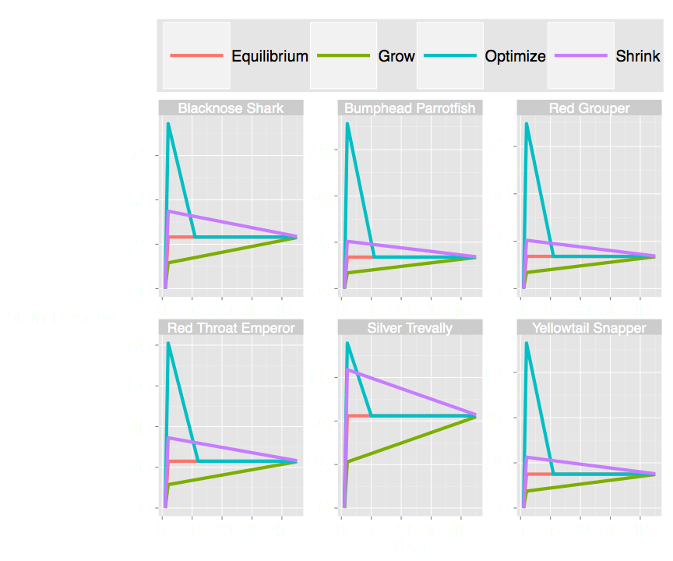

Slide 17
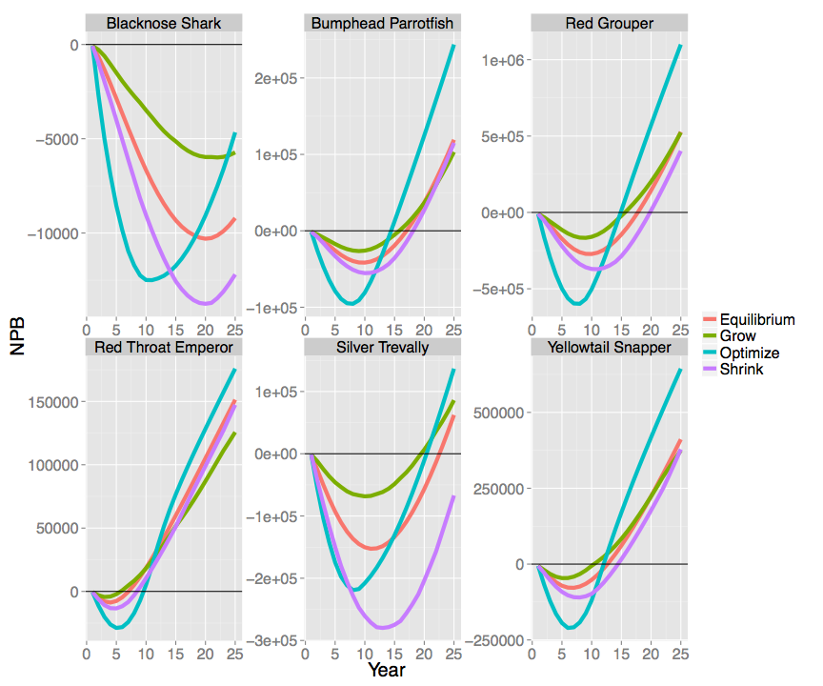

Slide 18
